Slide 1
REPT: Reverse Debugging of Failures in Deployed Software
Harshitha Nagapudi - hnagapud@ttu.edu
Texas Tech University

Slide 2
OUTLINE
Existing Problems
REPT as a Solution
How it Works
Evaluation
Limitations
Future Work
Conclusion

Slide 3



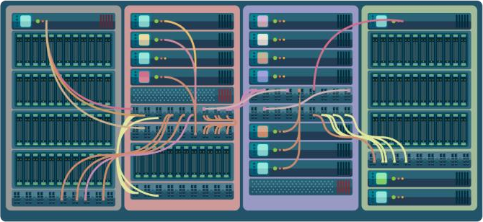

What happened before the crash?

Slide 4
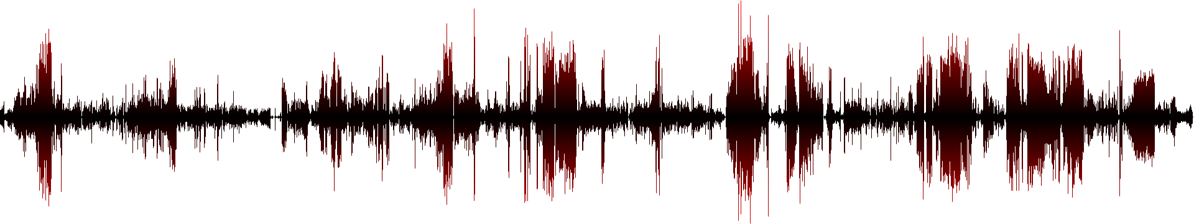




Slide 5
REPT: Reverse Execution with Processor Trace

Slide 6

REPT: Reverse Execution with Processor Trace
Online hardware tracing (e.g., Intel Processor Trace)
  Log the control flow with timestamps
  Low runtime overhead (1 – 5%)
  No data!
Offline binary analysis
  Recovers data flow from the control flow

Slide 7
REPT Data Recovery
Single-threaded execution reconstruction
Multi-threaded execution reconstruction

Slide 8

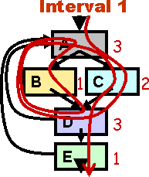

Core Dump
Instruction Sequence
Execution History
+
= ?
How to recover overwritten states

Slide 9
lea rbx, [g]
mov rax, 1
add rax, [rbx] mov [rbx], rax xor rbx, rbx

Slide 10



rax=?, rbx=?, [g]=3
lea rbx, [g]
rax=?, rbx=?, [g]=3
mov rax, 1
rax=?, rbx=?, [g]=3
add rax, [rbx]
rax=3, rbx=?, [g]=3
mov [rbx], rax
rax=3, rbx=?, [g]=3
xor rbx, rbx
rax=3, rbx=0, [g]=3

Slide 11
rax=?, rbx=?, [g]=3
lea rbx, [g]
rax=?, rbx=g?, [g]=3
mov rax, 1
rax=11?, rbx=g?, [g]=3 4?
add rax, [rbx]
rax=3, | rbx=g, | [g]=3
rax=3, | rbx=?, | [g]=3
rax=3, | rbx=0, | [g]=3
mov [rbx], rax
xor rbx, rbx

Slide 12
rax=?, rbx=?, [g]=?
lea rbx, [g]
rax=?, rbx=g, [g]=?
mov rax, 1
rax=1, rbx=g, [g]=?
add rax, [rbx]
rax=3, rbx=g, [g]=?
mov [rbx], rax
rax=3, rbx=g?, [g]=3
xor rbx, rbx
rax=3, rbx=0, [g]=3

Slide 13
rax=?, rbx=?, [g]=2?
lea rbx, [g]
rax=?, rbx=g, [g]=?2
mov rax, 1
rax=1, rbx=g, [g]=22?
add rax, [rbx]
rax=3, rbx=g, [g]=?
mov [rbx], rax
rax=3, rbx=g, [g]=3
xor rbx, rbx
rax=3, rbx=0, [g]=3

Slide 14
rax=?, rbx=?, [g]=2
lea rbx, [g]
rax=?, rbx=g, [g]=2
mov rax, 1
rax=1, rbx=g, [g]=2
add rax, [rbx]
rax=3, rbx=g, [g]=2?
mov [rbx], rax
rax=3, rbx=g, [g]=3
xor rbx, rbx
rax=3, rbx=0, [g]=3

Slide 15
rax=?, rbx=?, [g]=2
lea rbx, [g]
rax=?, rbx=g, [g]=2
mov rax, 1
rax=1, rbx=g, [g]=2
add rax, [rbx]
rax=3, rbx=g, [g]=2
mov [rbx], rax
rax=3, rbx=g, [g]=3
xor rbx, rbx
rax=3, rbx=0, [g]=3

Slide 16
Key Techniques
Forward Execution
  Recovers states before irreversible instructions
Error Correction
  Handles errors introduced by “missing” memory writes

Slide 17
REPT Data Recovery
Single-threaded execution reconstruction
Multi-threaded execution reconstruction

Slide 18
Core Dump
Instruction Sequence #1
Instruction Sequence #2
Execution History
+
+
= ?
How to determine the
thread interleavings?

Slide 19
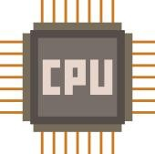
Time
A
B
C
D
E
F
G

Slide 20
Time
A
A
D
D
E
E
B
F
B
F
G
C
G
C

Slide 21
Time
A
D
E
B
F
G
C
A
D
10
E
B
F
G
C

Slide 22
Time
A
D
E
B
F
G
C
A
D
10
E
B
F
18 or 20
G
C

Slide 23

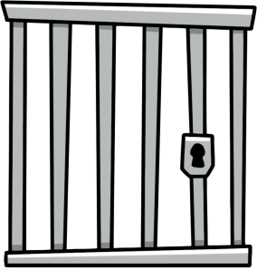

Time
A
D
E
B
F
G
C
A
D
10
E
B
F
18 or 20
G
C

Slide 24
Key Techniques
Hardware Timestamps
  Constructs a partial order
Concurrent memory write detection
  Constrains their usage to avoid propagating a wrong value

Slide 25
With REPT

Slide 26



I want history information!
Hey, client, turn on tracing next time.

Slide 27
Evaluation

Slide 28




1-5% overhead
16 bugs
14 bugs
92% accuracy

Slide 29
Limitations
The control flow trace may not be long enough to capture the defect e.g., the free call is not in the trace for a use-after-free bug.
Data values that are necessary for debugging the failure are not recovered e.g., the heap address passed to the free call is not recovered for a use-after-free bug.

Slide 30
Future Work
REPT currently does not capture any data during a program’s execution. To fundamentally solve these two limitations, we will need to log more data than just the memory dump.
While REPT’s core analysis is on machine instructions and thus independent of the privilege mode, we need to properly handle kernel-specific artifacts such as interrupts to support reverse debugging of kernel-mode executions.
Can study how program tracing can be combined with event logging to help developers debug bugs in distributed systems.

Slide 31
Conclusion
Debugging production failures is important but hard
REPT is a practical reverse debugging solution for production failures
  Online hardware tracing to log the control flow with timestamps
  Offline binary analysis to recover the data flow with high accuracy
REPT has been deployed on Microsoft Windows

Slide 32

REFERENCES
Cui, Weidong, et al. "{REPT}: Reverse debugging of failures in deployed software." 13th USENIX Symposium on Operating Systems Design and Implementation (OSDI 18). 2018.
Cui, Weidong, et al. "Retracer: Triaging crashes by reverse execution from partial memory dumps." 2016 IEEE/ACM 38th International Conference on Software Engineering (ICSE). IEEE, 2016.

Slide 33
THANKYOU

